Slide 1
Project Final Report
Recommendation System “Edible Me”
Sam YAN, originally as
Wenzhou-Kean University
B.S.Computer Science
Graduation Defense Project

Slide 2
Today's Topics
Background
Specifications
Design
Implementation
Future

Slide 3
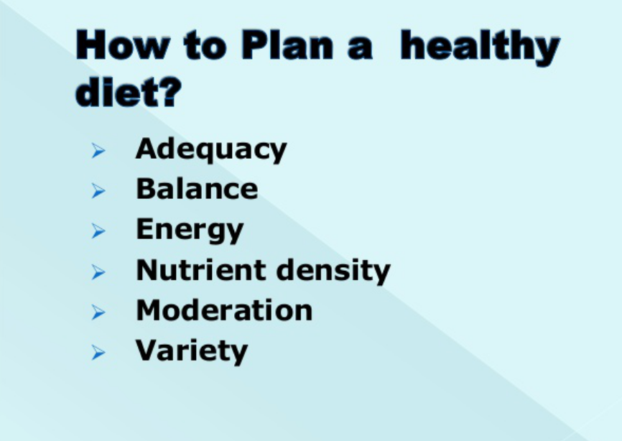
Introduction of background
Dietary planning: Planning diets according to certain factors.
Related also to person's flavor, status, current health condtions, processes of food and interactions between food.
Could be time consuming.
Is basically a decision-making process.
Information from Dr. Toby Mechelena, Course BIO 3200, Dietary planning, in Winter 2016

Slide 4
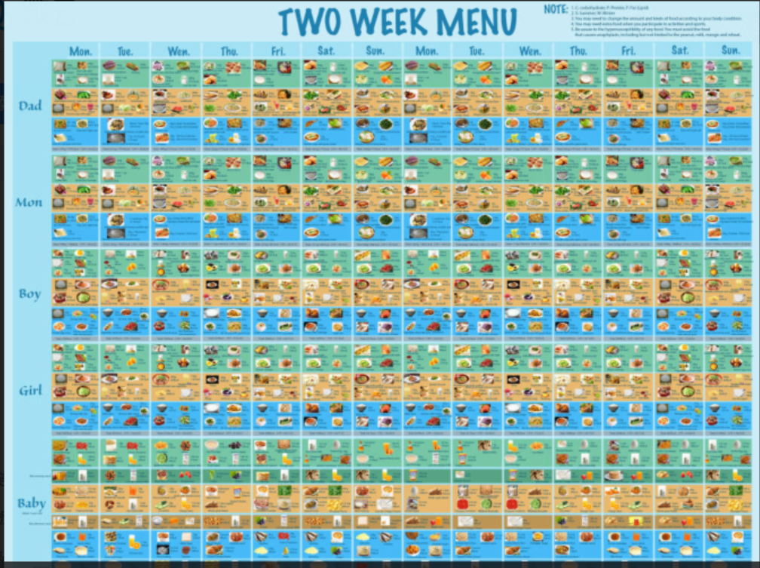
Freddy W., Jie W and Sam Y. Dietary planning work, in Winter 2016

Slide 5
Today's Topics
Background
Specifications
Design
Future

Slide 6
Phase I: Brain Storming
Factors (Entites)
Interactions (Relationships)
Functions
Implementation Details

Slide 7
KEY WORDS
Automatic, Decision making and “self-recommendation”

Slide 8
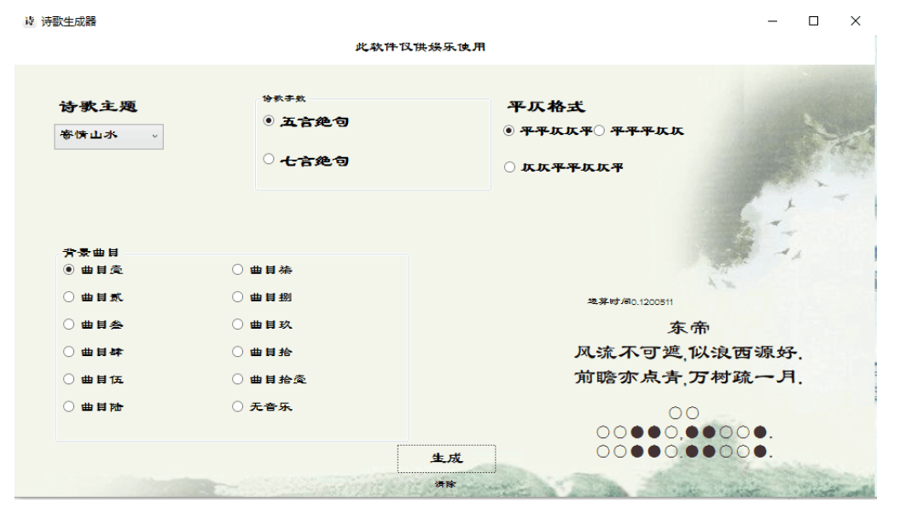
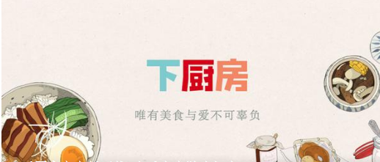
Related works

Slide 9
Today's Topics
Background
Specifications
Design
Future

Slide 10
Recommend Algorithm
User prohebit
Sample Food
User flavor

Slide 11
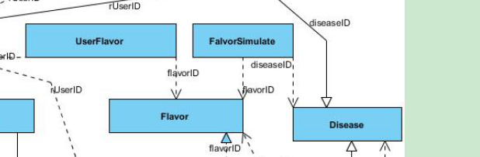
DB and Classes
3 Levels:
Database
Linking programs to DB
GUI
E-R relationship:

Slide 12
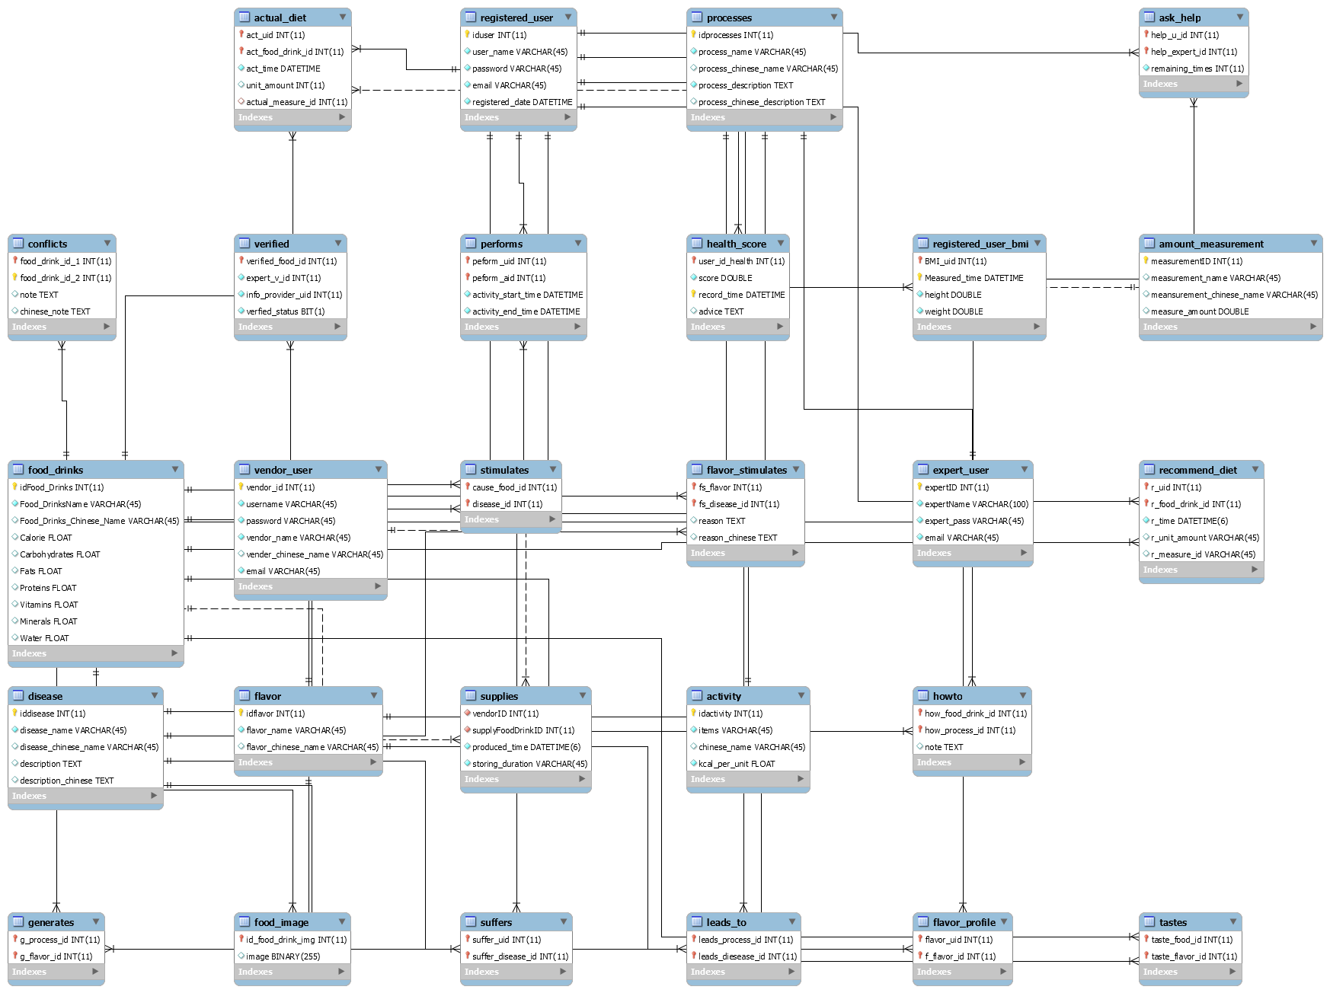
Phase II: Database Design
Consider factors of entities and relationships

Slide 13
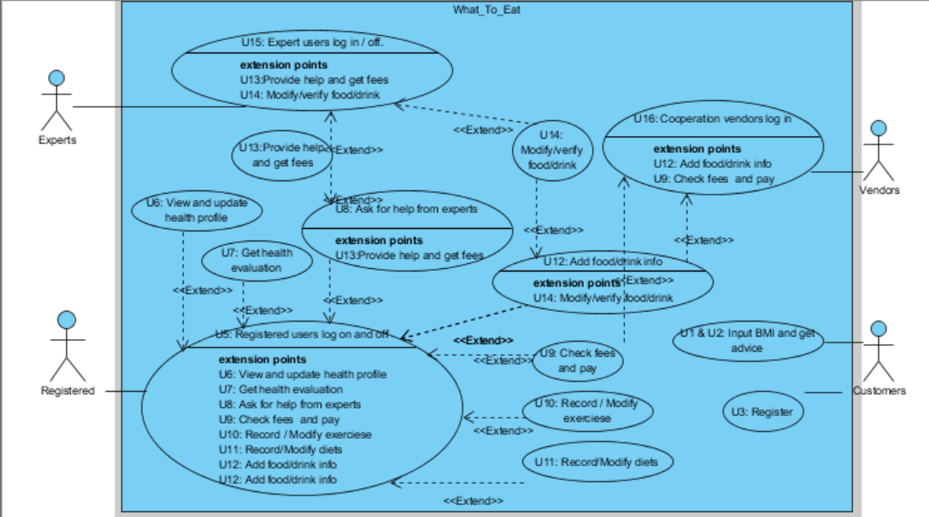
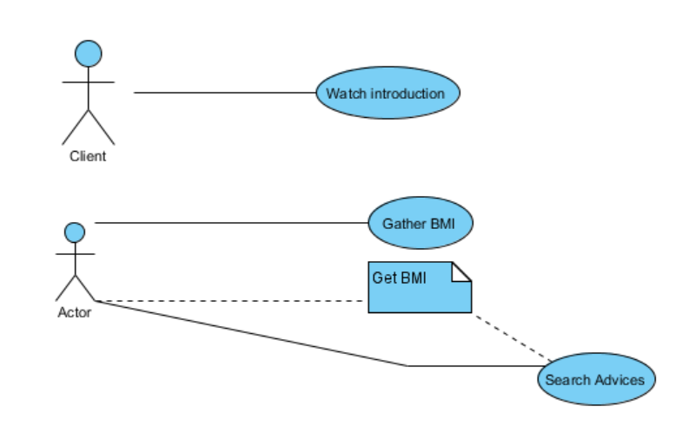
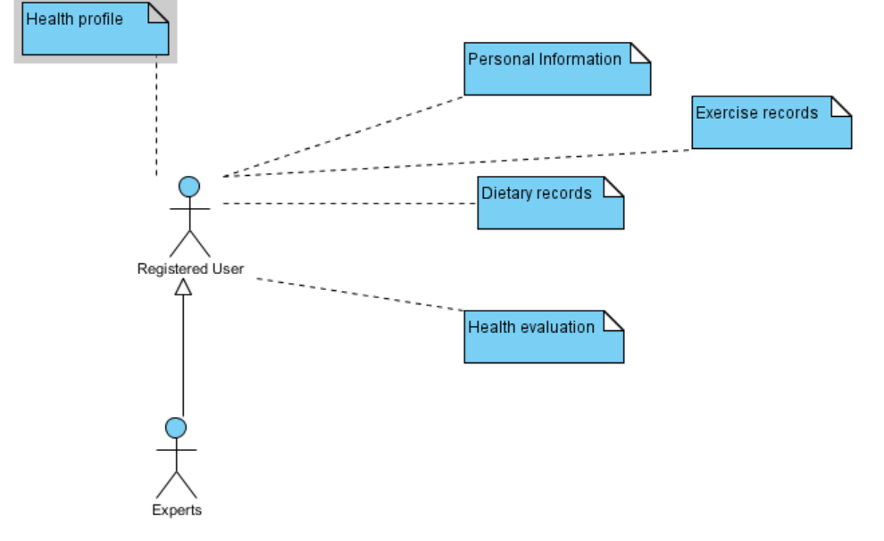
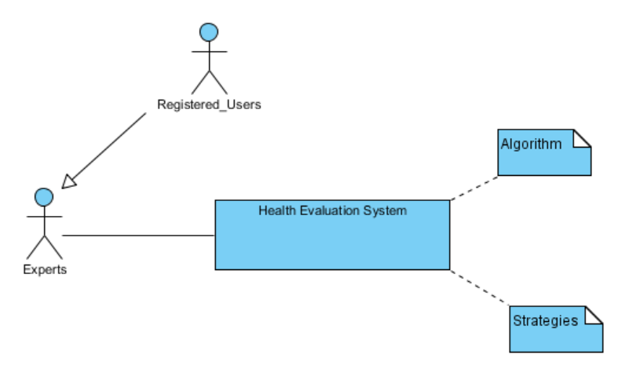
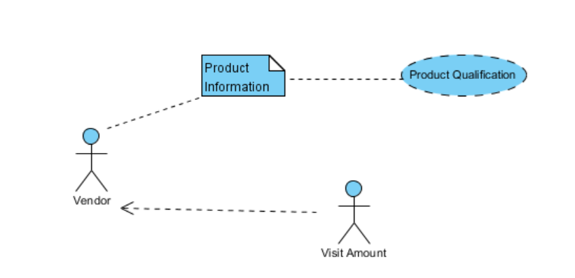
Phase III: Class Diagram
Consider the functions

Slide 14
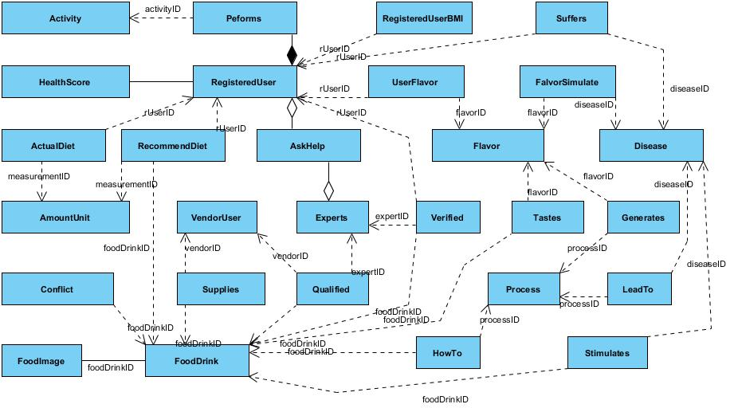
Phase IV: Implementation Details
How to implement the big E-R picture?

Slide 15
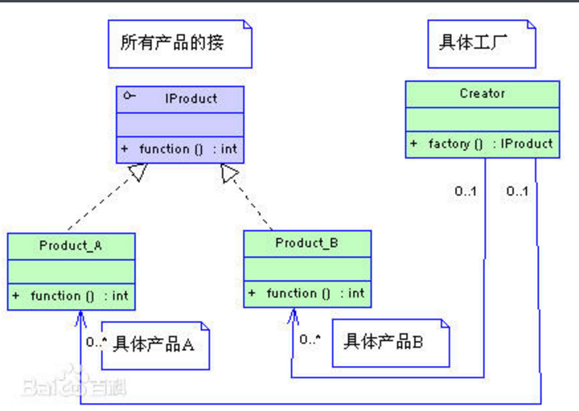
“Factory Pattern”
The Product is not directly calling the creator
Frame does not directly calling the entites, but its APIs.
Image of Factory Mode, URL: https://baike.baidu.com/pic/, used at 12:18, 10th, Apr, 2017

Slide 16
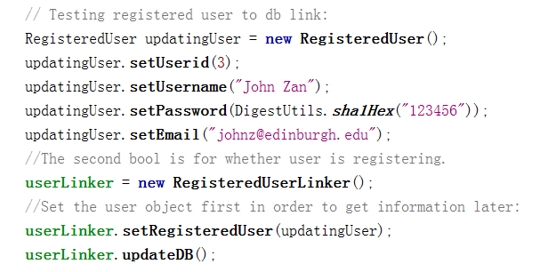
One-way encryption API
Using API org.apache.commons.codec.digest.DigestUtils;
Leave the encryption/ security processes at the program stage.
Access control itself is already a measurement in computer security. (Also might be attacked)

Slide 17
Today's Topics
Background
Specifications
Design
Future

Slide 18
Several Feedbacks:
“Your GUI has been ugly for four years” (Mrs. Leila)
Set algorithm -> Decision tree / Relationship mining (Mr.More)
Would like to use this app. in class (Dr.Toby)
Have to have an Android version (Dr.Zhang)
Have to consider users' location (Dr.Nasser, Haopeng)

Slide 19
Future works:
Improve GUI, move to Android
Implement as real Server-Client model
Add “vendors” to earn money
Consider other factors (e.g.location)

Slide 20
Today's Topics
Background
Specifications
Design
Future

Slide 21
Thanks for listening

Slide 22
Graduation Defence
Most Frequently Asked Questions

Slide 23

Q1: Why your GUI is ugly?
First, I sincerely apologize for my horrible GUI, I am sorry.
Basically, I am only given one month to finish the project and I am focusing more on the algorithm side, databases and classes design side, because those are more important works for both users and future works.
Secondly, personally I did not take Human-Computer Interaction due to historical reasons, whom is (probably) the only person in CS2017 who did not take HCI. and my research interest is not this area.
Also, as the designed three levels of the application, GUI is the least imporant element from this app. (Actually I wrote the GUI in the very last)
But, again, I am sorry to Dr.Tang, Dr.Zhang and all audiences for my ugly GUI.

Slide 24
Q2: How the whole system is implemented?
01
Create database linker classes
02
Test database linker classes
03
Implement recommendation algorithm
04
Implement GUI

Slide 25
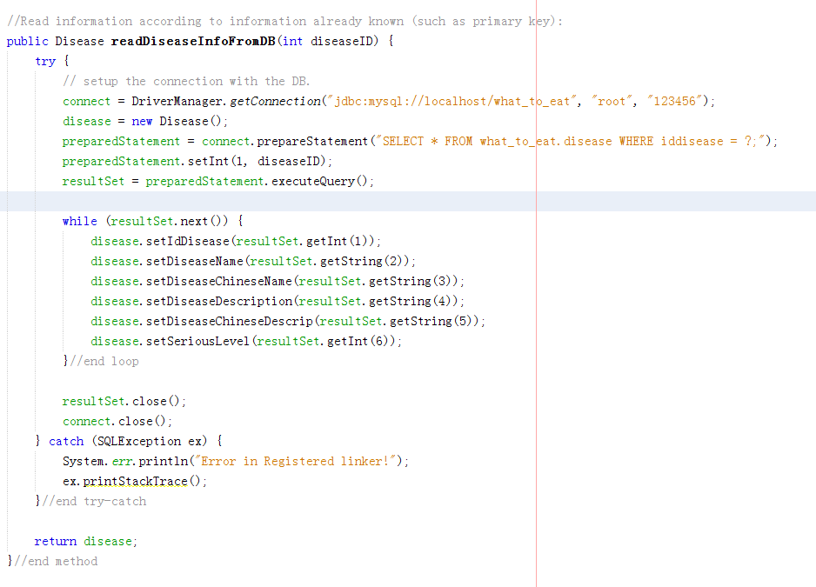
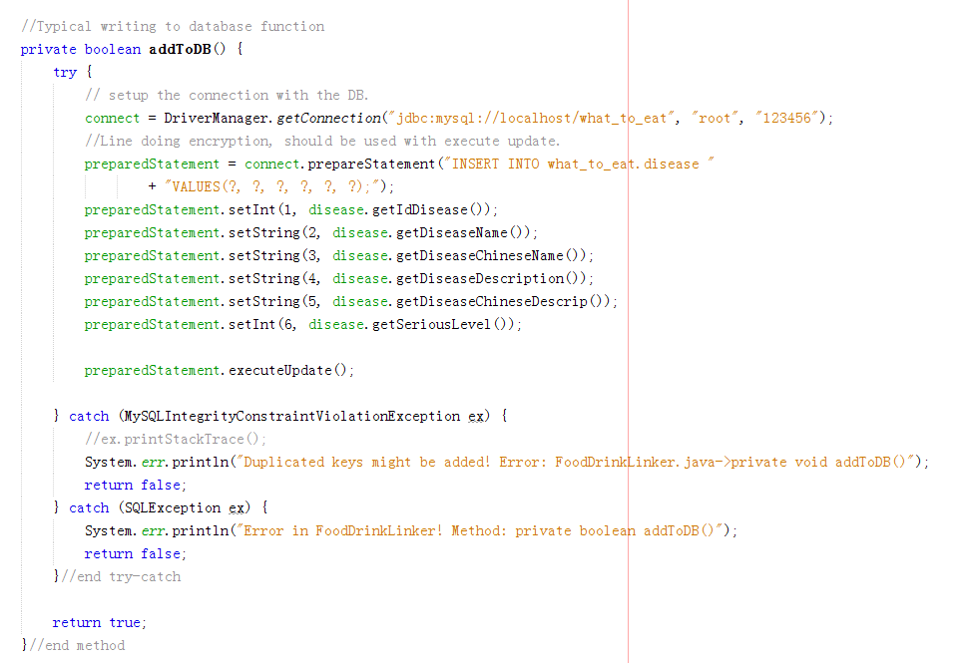
Stage 1: DBLinker

Slide 26
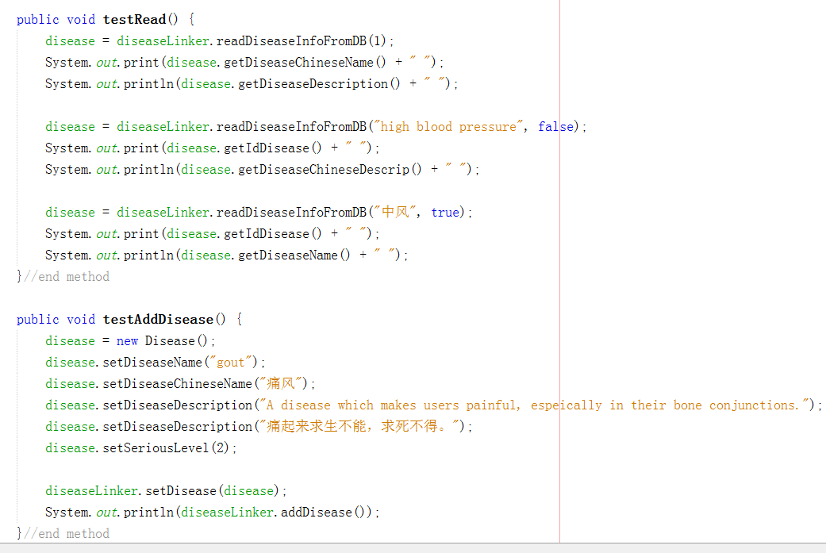
Stage 2: Test DBLinker

Slide 27
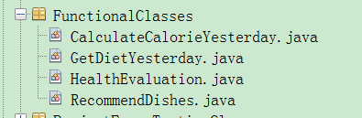
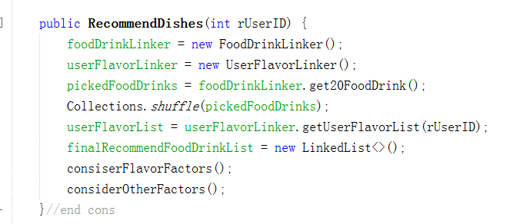
Stage 3: Implement Algorithm

Slide 28
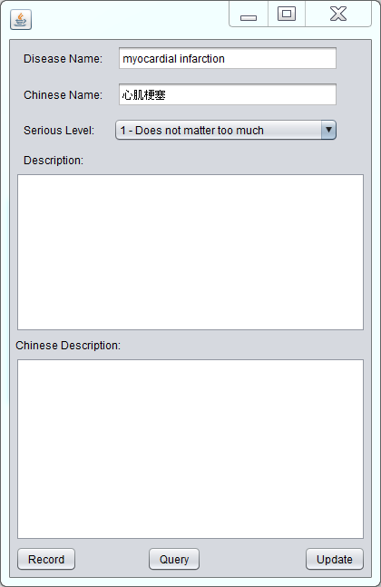
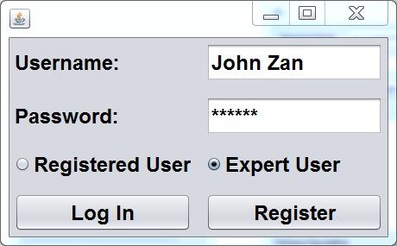
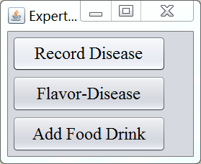
Stage 4: Graphical User Interface

Slide 29
Question 3: Why 5 dishes?
Originally deisgned for a whole family
A single user can have multiple choices

Slide 30
Q4: Are there any moments your app does not work as expected?
For about 50 users arrived and consulted yesterday, 46 got their fulfilled results, but there are some embarrasing moments.
E.g.1 Recommended “pork” to a Pakistan professor, and I am terribly sorry because my original design did not consider location / culture issues.
E.g.2 Recommend all vegetables (though high cal) to a malnutrition user.
Conclusion: About 92% of accuracy, overall reliable, but needs improving.

Slide 31
Q5: Data consistancy and collision issues?
When multiple windows of this app is open, different data might be input to DB system.
The system took the last input as the trusted input as the general method done by similar works.

Slide 32
Q6: Evaluation of your whole progress?
Objectively, has following pitfalls / good parts:
Original design of project duration has obvious pitfalls.
Most of the user cases (60.5%) are satisfied.
5 out of 9 GUI functions are satisfied.
The most important customers are fulfilled.
Future work and database extendsions are considered.

Slide 33
Q7: What did you learned during demonstration stages?
Users tend to have more expectations than developers expected.
GUI is the first element that immediately catches users attentions.

